Slide 1
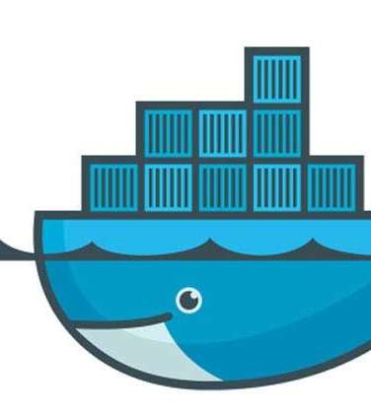

Docker Basics
A basic guide and kno how to docker.

Slide 2
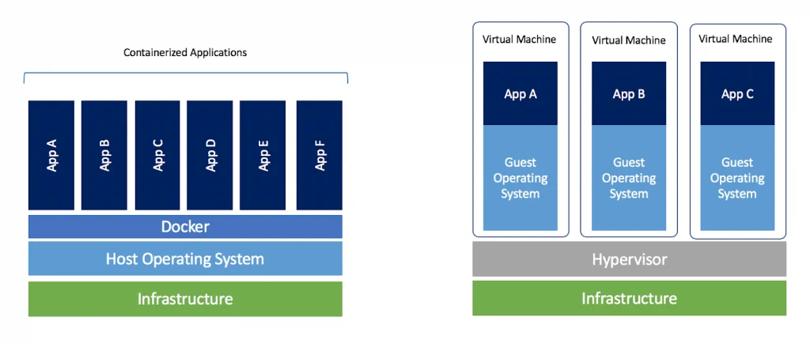
What is Docker?
A docker is a service which creates containers/Environments over all different technologies and ships them from one device to another or OS.
Containerize Applications
Run each service with its own dependencies in separate containers.

Slide 3
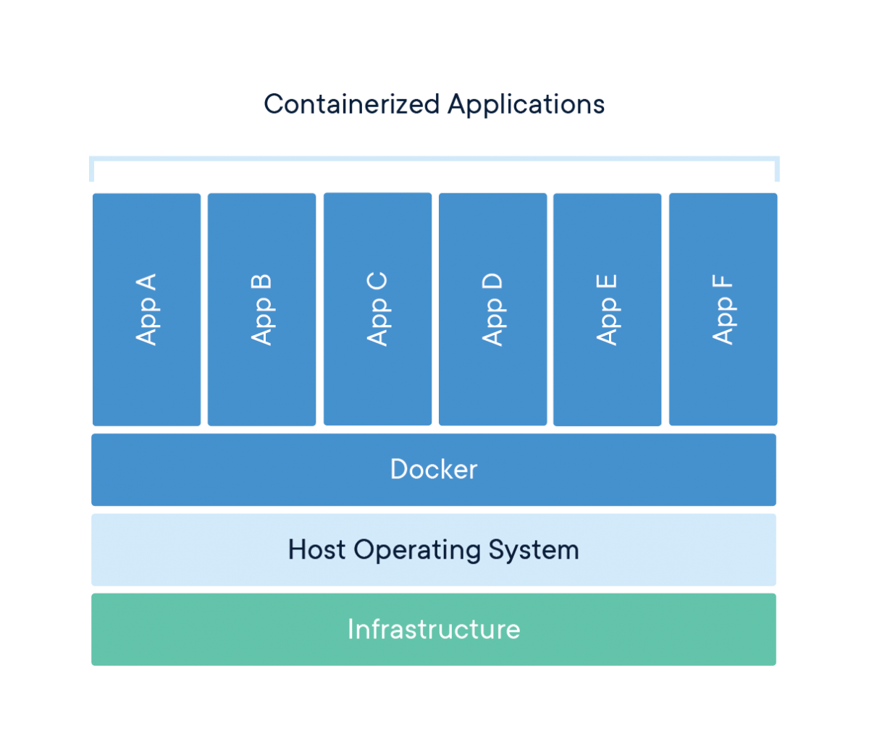
Why do we need Docker?
Sometimes we need to use many different technologies and libraries/architectures, for a single project eg (tensorflow,mongodb, nodejs, Django etc etc)
In order for it to work in all the system in a common fashion without having dependencies as such. The common problems include,
Compatiblity/Dependencies,
Long setup time,
Different Dev/Test/Prod environments.
To over come this problem we use a service known as docker.
Advantages of using Docker:
Can run on any OS on the same Kernel. (Ubuntu, Fedora OS, Cent OS etc).

Slide 4
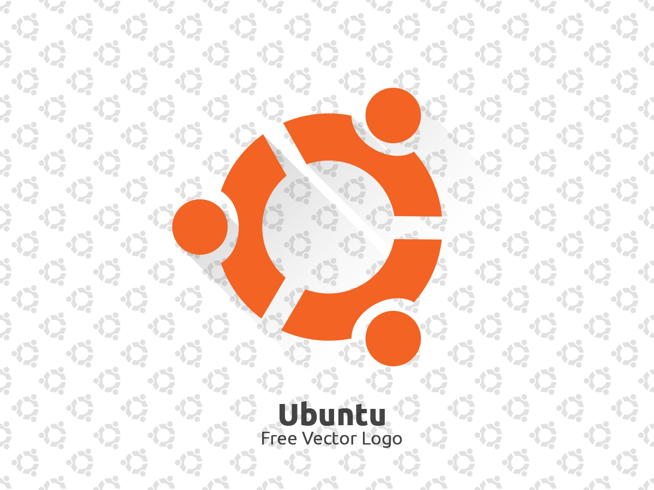


How’s it done?
The containers that we discussed above can be formed in “docker hubs”
These contains the images that is needed for the containerizing the packages for shipping on any OS.
It is simple as typing
Docker run redis
Docker run nodejs
Docker run nodejs.
(It is written twice cause we can create two different Nodejs containers ).
for creating the images and making containers for them.

Slide 5
Getting Started with Docker:
Docker install: www.docs.docker.com

